Slide 1
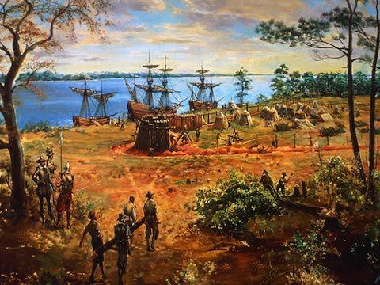
Thursday, September 1, 2016
Target Goal:
I will be able to explain the push-pull factors of the English coming to America
Please take out your chromebook and a pencil.
Bell Work:
What were 2 religions practiced and 2 industries found in the original 13 English Colonies.
¿Cuáles fueron 2 religiones practicadas y 2 se encuentran en las industrias de los 13 originales Inglés Colonias.

Slide 2
Today’s Objective
Students will be able to identify and explain the push-pull factors for the English migration to North America
Standard 8.1: Students understand the major events preceding the founding of the nation and relate their significance to the development of American constitutional democracy.
Standard WHST 8.4: Produce clear and coherent writing in which the development, organization, and style are appropriate to task, purpose, and audience.

Slide 3
Prior Knowledge
Push factors are issues that encourage a person to leave their home.
Pull factors are things that pull a person to another place.
Push Pull

Slide 4
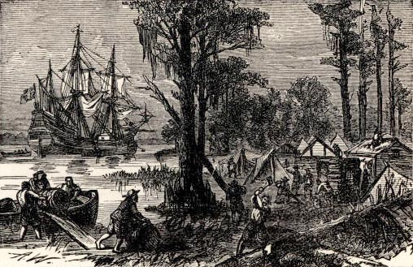
Concept
Beginning in the 1600s England began setting up colonies in North America. Eventually 13 colonies would be set up, each with different reasons as to why they left England.

Slide 5
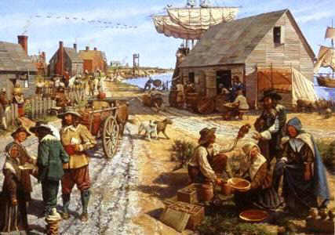
Concept
Push Factors
Religious persecution
Debt
Prison
Pull Factors
Gold (get rich!)
Land
Religious freedom
New life with better opportunities

Slide 6
Skill
Read the text
IDENTIFY: Underline push, circle pull
EXPLAIN: why does it represent a push or pull factor

Slide 7
Skill- I DO
Jamestown:
More than 100 people braved an Atlantic crossing and set up the first permanent English settlement in North America in 1607...Life in Virginia was very hard. The colonists had come hoping to find gold or silver. Instead, they could barely find enough to eat. Many settlers died from starvation and the cold winters, and others were killed in clashes with Native Americans.
Read the text
IDENTIFY. Underline push, circle pull
EXPLAIN. why does it represent a push or pull factor
I underlined “hoping to find gold” as a pull factor. It represents a pull factor because the colonists left England in search of the gold and silver they thought existed in North America.
I (underlined/circled) as a (push/pull factor).
It represents a (push/pull factor) because _______.

Slide 8
Skill- WE DO
Persecuted - subject (someone) to hostility and ill-treatment, especially because of their race or political or religious beliefs
Read the text
IDENTIFY. Underline push, circle pull
EXPLAIN. why does it represent a push or pull factor
Massachusetts:
Persecuted Puritans began leaving England for America in 1629. They formed a company and received a royal charter to settle an area north of Plymouth...the Puritans landed in America and founded the colony of Massachusetts and its capital, Boston.
I underlined “Persecuted Puritans” as a push factor. It represent a push factor because the colonists were being punished for their religion in England and needed a place they could practice freely.
I (underlined/circled) as a (push/pull factor).
It represents a (push/pull factor) because _______.

Slide 9
Skill- YOU DO
Rhode Island:
Rhode Island was founded by the Puritan minister Roger Williams. Williams believed that people should be free to follow their consciences in religious matters. In his view, the church and the government should be completely separate.
Read the text
IDENTIFY. Underline push, circle pull
EXPLAIN. why does it represent a push or pull factor
I (underlined/circled) as a (push/pull factor).
It represents a (push/pull factor) because _______.

Slide 10
Skill- Independent Practice.
New York:
In 1664 an English fleet took control of the prized port of New Amsterdam from the Dutch. King Charles II gave control of the new colony to his brother who renamed it New York. Colonists were driven by the desire for wealth making New York one of the fastest-growing commercial ports in England’ American colonies.
Read the text
IDENTIFY. Underline push, circle pull
EXPLAIN. why does it represent a push or pull factor
I (underlined/circled) as a (push/pull factor).
It represents a (push/pull factor) because _______.

Slide 11
Closure
Identify the push factors for English colonists.
Identify the pull factors for English colonists.

